Slide 1


Hotel Reservations Analysis
By SQL

Slide 2

Objective
The hotel industry relies on data to make informed decisions and provide a better guest experience.
In this project, I will work with a hotel reservation dataset to gain insights into guest preferences, booking trends, and other key factors that impact the hotel's operations.
I will use SQL to query and analyze the data, as well as answer specific questions about the dataset.

Slide 3
Dataset Details
The dataset includes the following columns:
Booking_ID: A unique identifier for each hotel reservation.
no_of_adults: The number of adults in the reservation.
no_of_children: The number of children in the reservation.
no_of_weekend_nights: The number of nights in the reservation that fall on weekends.
no_of_week_nights: The number of nights in the reservation that fall on weekdays.
type_of_meal_plan: The meal plan chosen by the guests.
room_type_reserved: The type of room reserved by the guests.
lead_time: The number of days between booking and arrival.
arrival_date: The date of arrival.
market_segment_type: The market segment to which the reservation belongs.
avg_price_per_room: The average price per room in the reservation.
booking_status: The status of the booking.

Slide 4

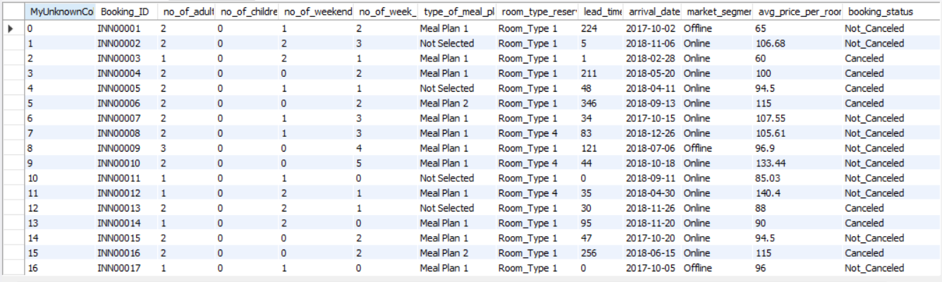
SQL HOTEL DATASET

Slide 5
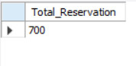
1. What is the total number of reservations in the dataset?
SELECT COUNT(*) AS Total_Reservation
FROM hotel_reservation;

Slide 6
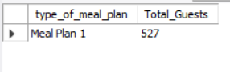
2. Which meal plan is the most popular among guests?
SELECT type_of_meal_plan, COUNT(Booking_ID) AS Total_Guests
FROM hotel_reservation
GROUP BY type_of_meal_plan
ORDER BY Total_Guests DESC
LIMIT 1;

Slide 7
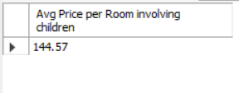
3. What is the average price per room for reservations involving children?
SELECT
ROUND (AVG (avg_price_per_room), 2) AS "Avg Price per Room involving children"
FROM hotel_reservation
WHERE no_of_children > 0;

Slide 8
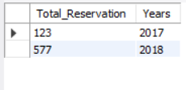
4. How many reservations were made for the years.
SELECT COUNT(Booking_ID) AS Total_Reservation, YEAR(arrival_date) AS Years
FROM hotel_reservation
WHERE YEAR(arrival_date) IN (2017, 2018)
GROUP BY Years;

Slide 9
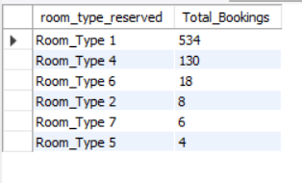
5. What is the most commonly booked room type?
SELECT room_type_reserved, COUNT(room_type_reserved) AS Total_Bookings
FROM hotel_reservation
GROUP BY room_type_reserved
ORDER BY Total_Bookings DESC;

Slide 10
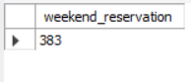
6. How many reservations fall on a weekend (no_of_weekend_nights > 0)?
SELECT COUNT(Booking_ID) AS weekend_reservation
FROM hotel_reservation
WHERE no_of_weekend_nights > 0;

Slide 11
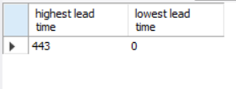
7. What is the highest and lowest lead time for reservations?
SELECT MAX(lead_time) AS "highest lead time",
MIN(lead_time) AS "lowest lead time"
FROM hotel_reservation;

Slide 12
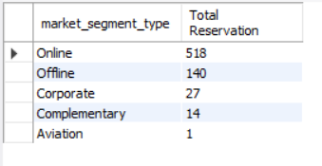
8. What is the most common market segment type for reservations?
SELECT market_segment_type, COUNT(Booking_ID) AS "Total Reservation"
FROM hotel_reservation
GROUP BY market_segment_type
ORDER BY COUNT(Booking_ID) DESC;

Slide 13
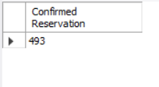
9. How many reservations have a booking status of "Confirmed"?
SELECT COUNT(Booking_ID) AS "Confirmed Reservation"
FROM hotel_reservation
WHERE booking_status = "Not_Canceled";

Slide 14
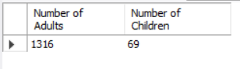
10. What is the total number of adults and children across all reservations?
SELECT SUM(no_of_adults) AS "Number of Adults",
SUM(no_of_children) AS "Number of Children"
FROM hotel_reservation;

Slide 15
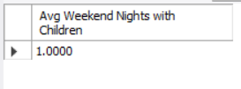
11. What is the average number of weekend nights for reservations involving children?
SELECT AVG(no_of_weekend_nights) AS "Avg Weekend Nights with Children"
FROM hotel_reservation
WHERE no_of_children > 0;

Slide 16
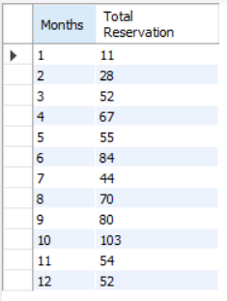
12. How many reservations were made in each month of the year?
SELECT MONTH(arrival_date) AS Months,
COUNT(Booking_ID) AS "Total Reservation"
FROM hotel_reservation
GROUP BY Months
ORDER BY Months;

Slide 17
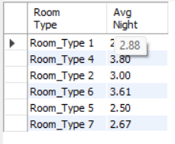
13. What is the average number of nights (both weekend and weekday) spent by guests for each room type?
SELECT room_type_reserved AS "Room Type",
ROUND(AVG(no_of_weekend_nights + no_of_week_nights), 2) AS "Avg Night"
FROM hotel_reservation
GROUP BY room_type_reserved;

Slide 18
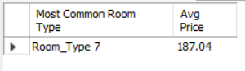
14. For reservations involving children, what is the most common room type, and what is the average price for that room type?
SELECT room_type_reserved AS "Most Common Room Type",
ROUND(AVG(avg_price_per_room), 2) AS "Avg Price“ FROM hotel_reservation
WHERE no_of_children > 0
GROUP BY room_type_reserved
ORDER BY ROUND(AVG(avg_price_per_room), 2) DESC LIMIT 1;

Slide 19
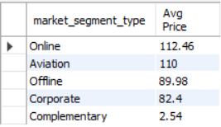
15. Find the market segment type that generates the highest average price per room.
SELECT market_segment_type, ROUND(AVG(avg_price_per_room), 2) AS "Avg Price"
FROM hotel_reservation
GROUP BY market_segment_type
ORDER BY AVG(avg_price_per_room) DESC;

Slide 20

Conclusion
the analysis of the hotel reservation dataset reveals clear trends and preferences among guests.
September and October were peak months in 2017, while March, April, May, June, August, and October stood out in 2018.
Around 70% of reservations were confirmed, emphasizing a strong booking rate, with online bookings comprising 73% of total reservations.
Room_type_1 and Meal plan_1 were consistently favored choices, especially among families with children.
Weekends showed increased booking activity, and specific market segments consistently booked higher rates.
These insights provide valuable opportunities for the hotel to refine its offerings, target marketing strategies effectively, and enhance guest experiences.
By leveraging these findings, the hotel can better cater to guest preferences, optimize pricing strategies, and ultimately increase bookings and revenue.

Slide 21




Thanks!

